Slide 1
Office Sponsored Programs (OSP) Pre-Award Administration
Cayuse SP Instructions for Review of Proposals by Deans, Directors, and Department Chairs

Slide 2
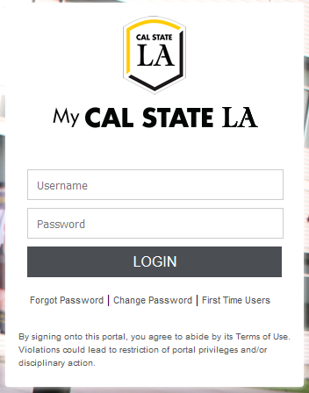
Cayuse Login: https://uascalstatela.cayuse424.com/
Username: Your Cal State LA ID (eg. LastName123)
Password: Your single sign-on Cal State LA password

Slide 4
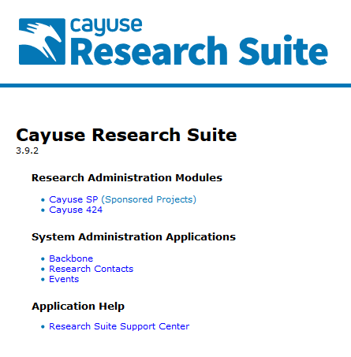
Click the
Sponsored Projects
link

Slide 5
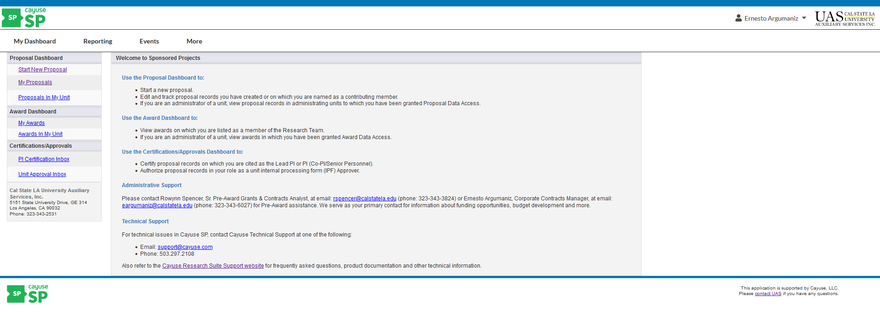
When an Approval Form is submitted, it will be routed through a chain of approvers before the proposal is submitted to the sponsor. If you are an IPF approver and your unit is in an Approval Form's routing chain, you will need to approve the Approval Form before it can progress further through the chain.

Slide 6
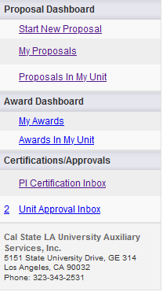
Reviewing an Approval Form
If you have submissions to approve, you will see a number next to Unit Approval Inbox. Click on your Unit Approval Inbox. You will also be notified via email when an Approval Form is in need of approval.

Slide 7
Beneath the To Be Authorized tab, you will see a list of Approval Forms in need of approval. Click on the proposal number to visit the routing status page.

Slide 8
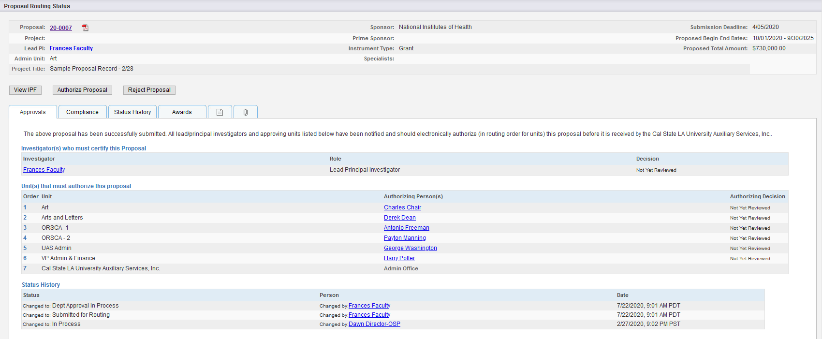
The Proposal Routing Status Page
1
2
3
4
5

Slide 9
General Information: shows basic information, such as proposal and project numbers, lead PI, sponsor, and submission deadline.
Proposal Review: provides options to review, authorize, or reject a proposal. You can also authorize or a reject a proposal when viewing it.
Informational Tabs: provides additional data regarding the submission, including awards and pre-award spending requests. The Compliance tab will show associated research protocols, but only after the submission has been approved.
Routing Information: shows a list of authorizing individuals and units and where the submission is within the routing process. If a unit does not have an authorizing person, one will need to be added for that unit before a submission can advance through the routing chain. Contact your administrator to add an approver to a unit.
Status History: shows time stamps of submission status changes

Slide 10
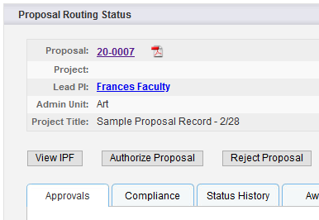
Reviewing an Approval Form
You can review the Approval Form by clicking on the PDF icon or proposal number.
You can also review the Approval Form by clicking View IPF on the proposal routing screen.

Slide 11
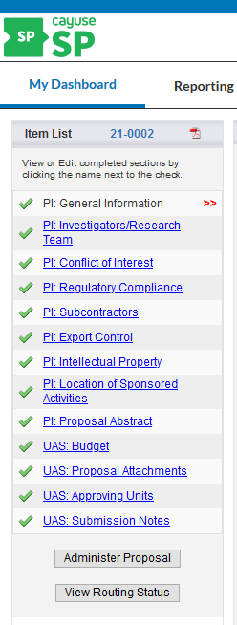
When viewing the Approval Form, you can use the left-hand menu to toggle between each section and view its contents.

Slide 12
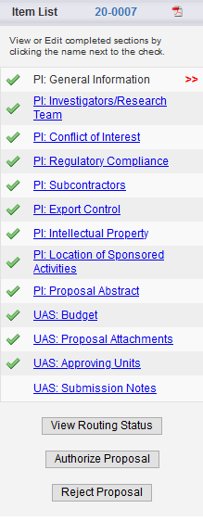
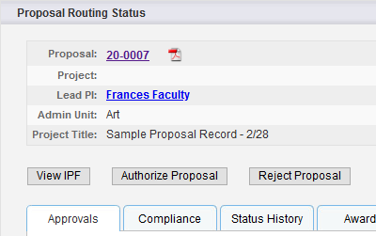
Authorizing or Rejecting an Approval Form
After review, click Authorize Proposal or Reject Proposal.

Slide 13
Authorizing an Approval Form
Enter any comments you have regarding the Approval Form. Your comments will be visible to the Research Team, proposal reviewers, and the UAS Office Sponsored Programs (OSP), Pre-Award Administration.
Click Submit Authorization to acknowledge the authorization statement.
If you authorize the Approval Form, the next Approver will receive an email notifying them that they need to review the Approval Form.

Slide 14
Rejecting an Approval Form
Enter any comments you have regarding the Approval Form. Your comments will be visible to the Research Team, proposal reviewers, and the UAS Office Sponsored Programs (OSP), Pre-Award Administration.
Click Submit Rejection to acknowledge the authorization statement. When you reject an Approval Form, it receives the status Reopened, and the Research team and creator will be able to edit it and resubmit it for routing.

Slide 15
Please remember to contact the UAS Office Sponsored Programs (OSP) Pre-Award Administration at any time if you need assistance.
Rowynn Spencer, Senior Pre-Award Grant & Contract Analyst, ext. 3-3824, rspencer@calstatela.edu
Ernesto Argumaniz, Corporate Contracts Manager, ext. 3-6027, eargumaniz@calstatela.edu

