Slide 1
Cal State LA University Auxiliary Services, Inc.
Overview of Cayuse SP

Slide 2
Cayuse Suite at
Cal State LA University Auxiliary Services, Inc.
Sponsored Projects
424
SP (Sponsored Projects)
Federal Proposals
(grants.gov)
Proposal Submission
Other Proposal Systems
Routing/Approval
Proposal Files
Award Management
(non-Financial)
Other Proposal Systems and
Non-Federal Proposals

Slide 3
Beginning June 1, 2020
All proposals are to be routed and/or submitted through Cayuse SP

Slide 4
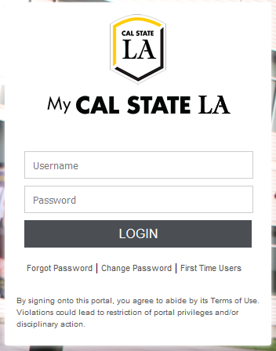
Cayuse Login: https://uascalstatela.cayuse424.com/
Username: Your Cal State LA ID (eg. LastName123)
Password: Your single sign-on Cal State LA password

Slide 6
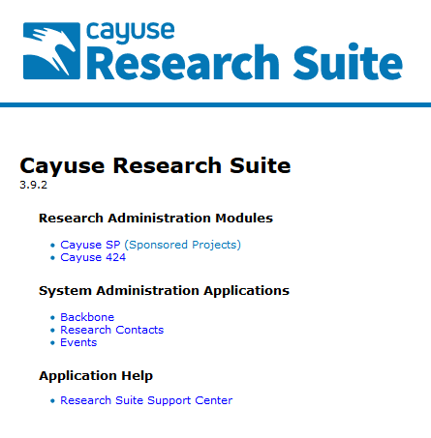
Click the
Sponsored Projects
link

Slide 7
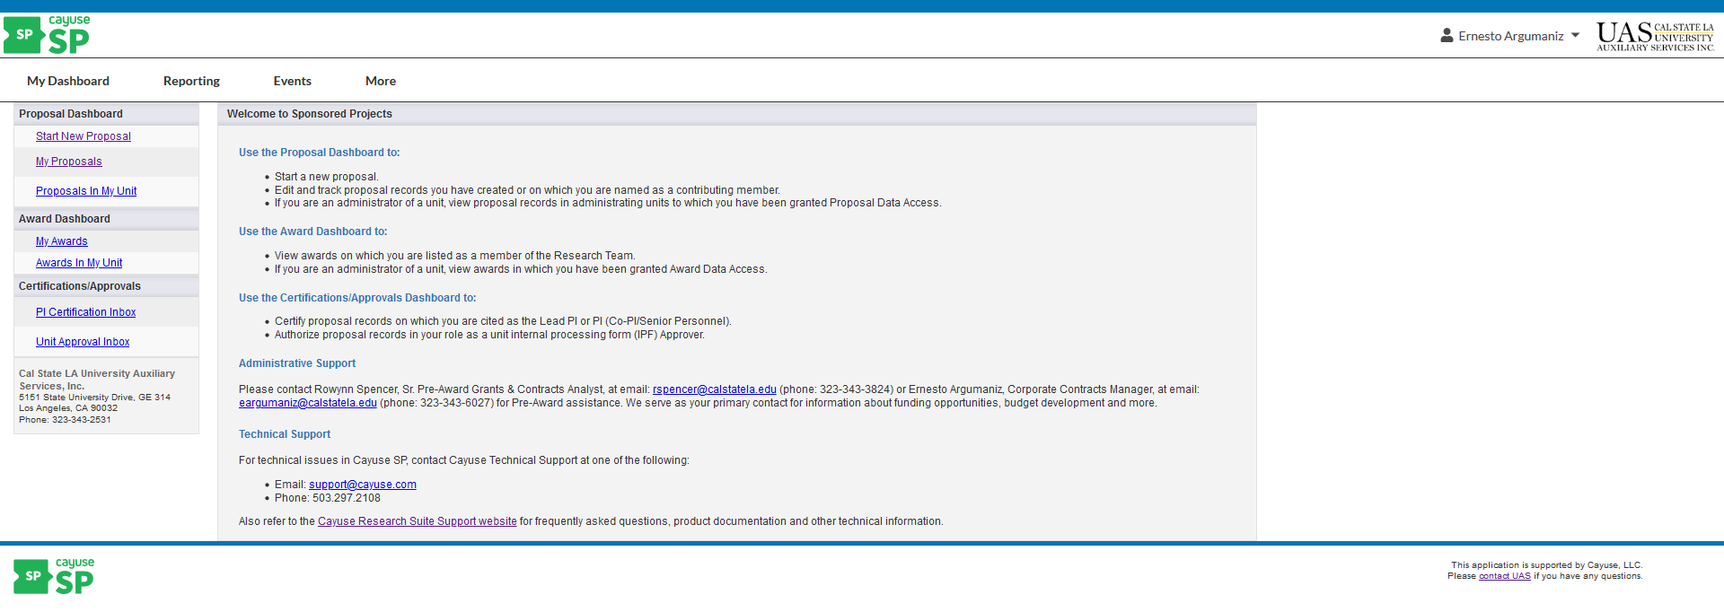
You have arrived at the Cayuse SP Navigation Page

Slide 8
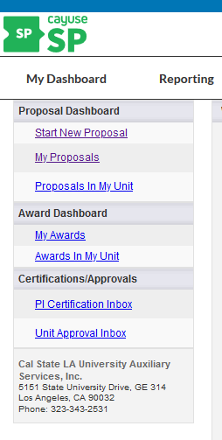
Cayuse SP has multiple Menus and Dashboards for convenient access to project information.
Menus:
My Dashboard
Reporting
Dashboards:
Proposal Dashboard
Award Dashboard
Certifications/Approvals

Slide 9
PROPOSAL DASHBOARD
Start New Proposal
Click Start New Proposal

Slide 10
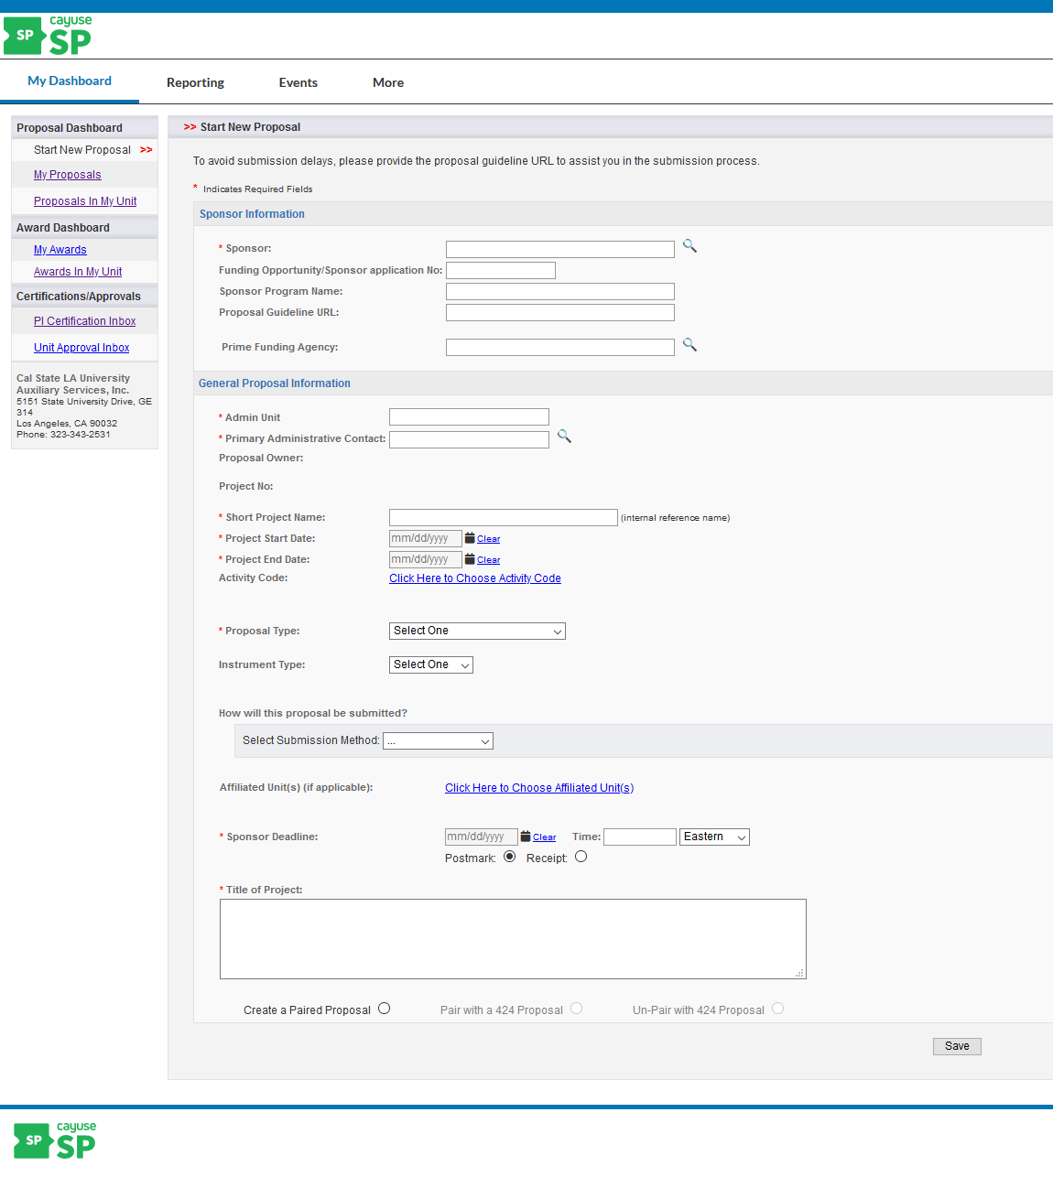
This basic proposal information needs to be completed to start a proposal.

Slide 11
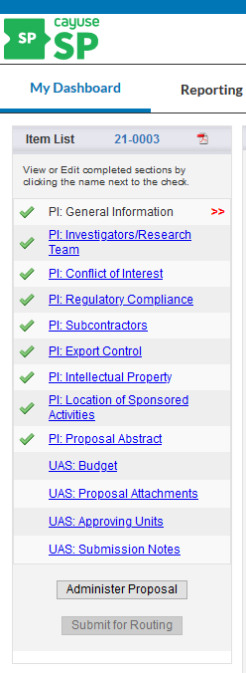
Once this information has been completed and saved, the Item List will appear on the left.
The double red arrow indicates the section of the Item List you’re currently on
A green check mark will appear in the Item List, indicating that all required information is complete for a section
If the proposal is paired with a Cayuse 424 application (for federal submission purposes), the pairing icon will appear
Throughout the proposal, an asterisk (*) indicates that a response is required and must be addressed before the page can be saved. You will receive an error message if you try to save without completing the required information.

Slide 12
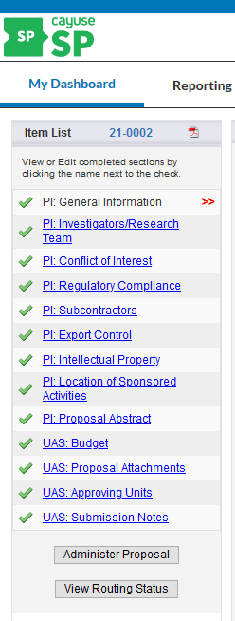
A completed Item List will appear as follows

Slide 13
PROPOSAL DASHBOARD
My Proposals:
Allows you to edit and track unsubmitted and submitted proposals that you created or are named on as a contributing member
The number to the left of My Proposals in the dashboard list indicates the number of proposals in progress, if any.

Slide 14
Unsubmitted proposals are shown by default on the left. Submitted proposals are shown under the tab to the right.
NOTE: “Submitted” here refers to submitted for University approvals, not submitted to sponsor.

Slide 15
Proposal in My Unit:
Applicable to Chairs, Deans and individuals with proposal data access

Slide 16
AWARD DASHBOARD
My Awards:
Awards lists awards received
Active Projects (currently funded projects)
Inactive Projets (projects that have ended)

Slide 17
Awards My Unit
Applicable to Chairs, Deans and individuals with award data access. This access can be requested from the UAS Office of Sponsored Programs, Pre-Award Department .

Slide 18
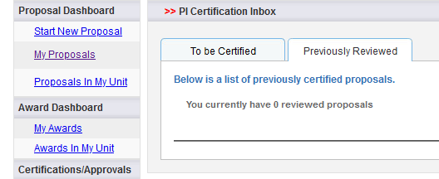
CERTIFICATIONS/APPROVALS
PI Certification Inbox
To be Certified: Lists items awaiting Principal Investigator (PI) /Lead PI certification
Previously Reviewed: List of items already addressed

Slide 19
Unit Approvals Inbox would be applicable to Chairs, Deans and individuals with award data access, which can be requested from the UAS Office of Sponsored Programs, Pre-Award Department.
To be Authorized: Lists items awaiting approval
Previously Reviewed: List of items already addressed

Slide 20
REPORTING
Menu:
Reporting
The Reporting page is divided into three major categories: Proposals, Awards, and Projects. You can view reports on proposal activity, funding rates, awards by unit, PI, sponsor, and other categories. Reports can be exported to Excel to further customize the data. All users in Cayuse SP can run reports, but the ability to see record data in the report format is limited to those users with access to that record, usually the research team and unit personnel. For more information on reporting, contact UAS.

Slide 21
Please remember to contact the UAS Office of Sponsored Programs, Pre-Award Department at any time if you need assistance.
Rowynn Spencer, Senior Pre-Award Grant & Contract Analyst, ext. 3-3824, rspencer@calstatela.edu
Ernesto Argumaniz, Corporate Contracts Manager, ext. 3-6027, eargumaniz@calstatela.edu

